Slide 1
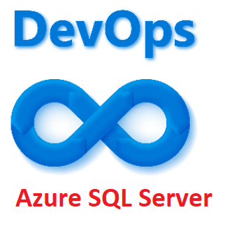

Azure SQL Server & DevOps
Session subtitle
Alpa Buddhabhatti
Azure Consultant at Cluster Reply Alpa Buddhabhatti | LinkedIn
Azure Consultant at Cluster Reply Alpa Buddhabhatti | LinkedIn

Slide 2
Agenda
What is Azure DevOps ?
Tools
What is .DACPAC file?
DEMO
1. To Create .DACPAC file
2. To Create Visul studio project to impoty .dacpac file
3. Build Pipeline - Azure SQL Server
4. Release Pipeline – Azure SQL Server

Slide 3
Abstract
In this session ,I will show how to create CICD pipelines for Azure Sql Server. Also will show demo to deploy Azure SQL Server in different environment. This demo will also use the following technologies:
*Azure Key Vault *Azure SQL Server The main goal of this session is to provide basic knowledge of Azure DevOps so attendee will leave with Azure DevOps knowledge how to apply this in different scenarios.

Slide 4
1. What is Azure DevOps?

Slide 5
What is Azure DevOps?
Simplified process for creating a continuous integration (CI) and continuous delivery (CD) pipeline to Azure.
Bring your existing code and Git repo, Or select a sample application.
Comit & Push, provide Automation
Tutorial: Create a CI/CD pipeline for your existing code by using Azure DevOps Starter | Microsoft Docs

Slide 6
2. Tools

Slide 7
Tools
SSMS (Microsoft Sql Server Management Studio)
Visual Studio

Slide 8
3. What is .DACPAC file?

Slide 9
What is DACPAC ?
Data-tier Application component packages
Simplify the development, deployment and management of data-tie elements
Compressed zip folder
The model of the database designed (xml format)
Metadata information of database
Both the schema of the data + data records

Slide 10
4. DEMO

Slide 11
4. DEMO – DACPAC CREATION

Slide 12
4. DEMO – VISUAL STUDIO SOLUTION

Slide 13
4. DEMO – BUILD PIPELINE (CI)

Slide 14
4. DEMO – RELEASE PIPELINE (CD)

Slide 15
Conclusion
DATPAC using SSMS
Visual Studio solution
A fully automated process of building - pipeline
A fully automated process of releasing – pipeline
Deploy Azure Server & Database in different environment
Azure Key Vault with CICD Pipeline

Slide 16
Thank you !!!

Slide 17
Q&A

Slide 18
Resources
Introduction to Azure DevOps - YouTube

Slide 19
Part 1 – Set up SQL Project

Slide 20
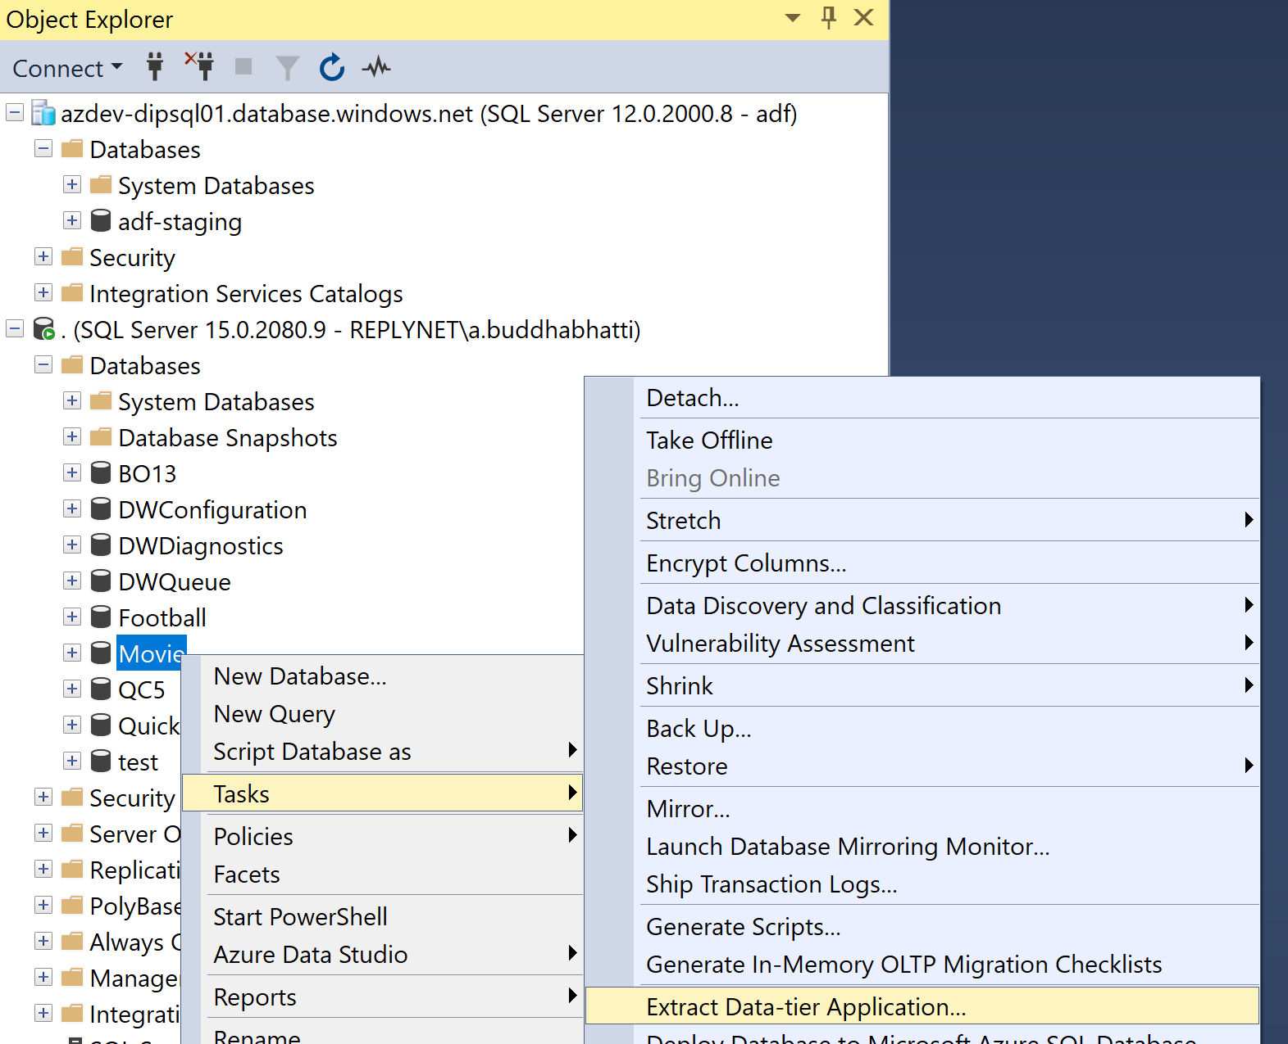
SSMS - Create dacpac from on-premise database

Slide 21
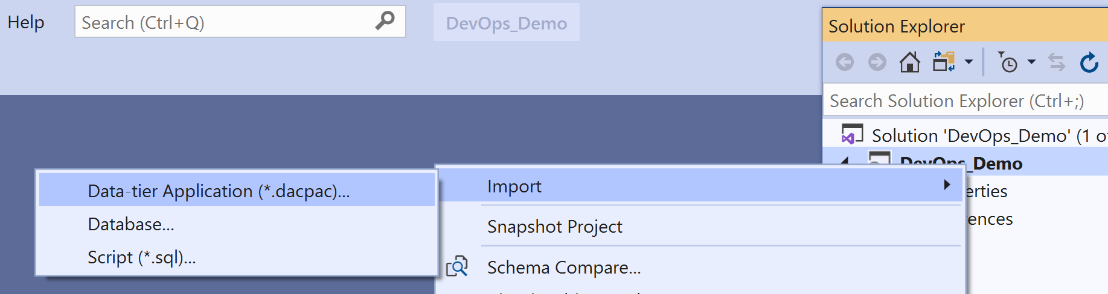
Visual studio 2019 - Import .dacpac

Slide 22
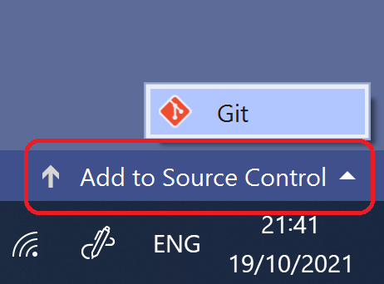
Visual studio 2019 – Add project to source control

Slide 23
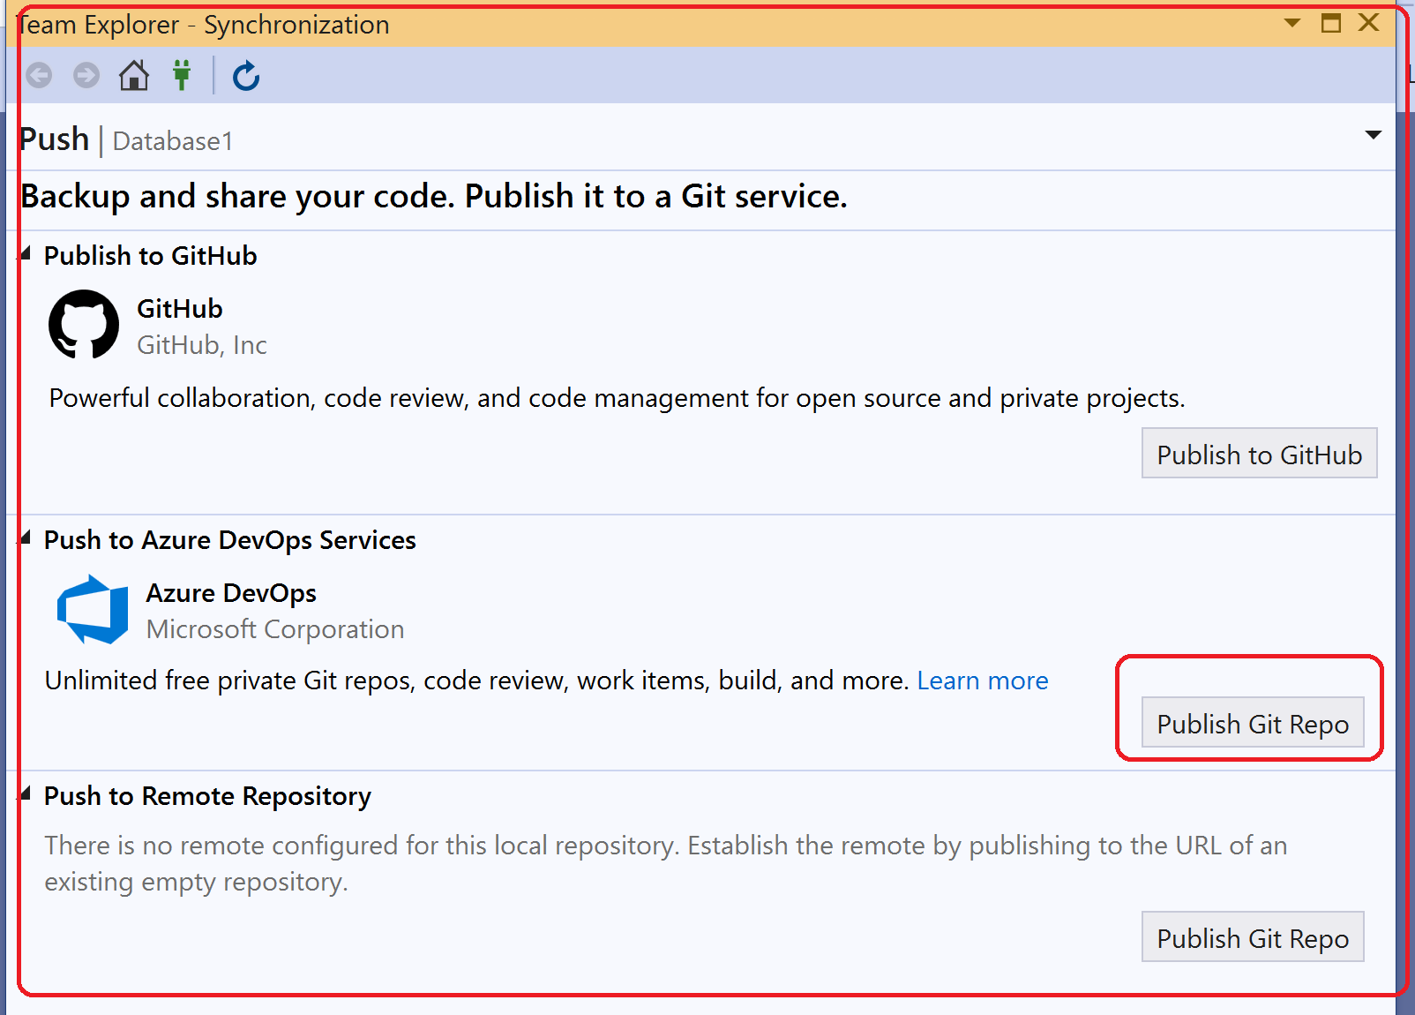
Visual studio 2019 – Publish Git Repo

Slide 24
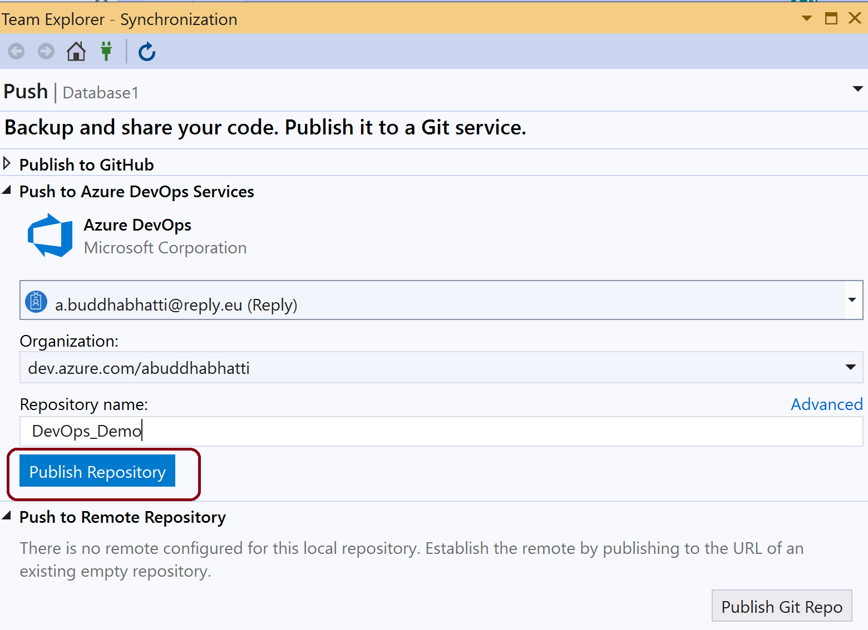
Visual studio 2019 – Publish Repository

Slide 25
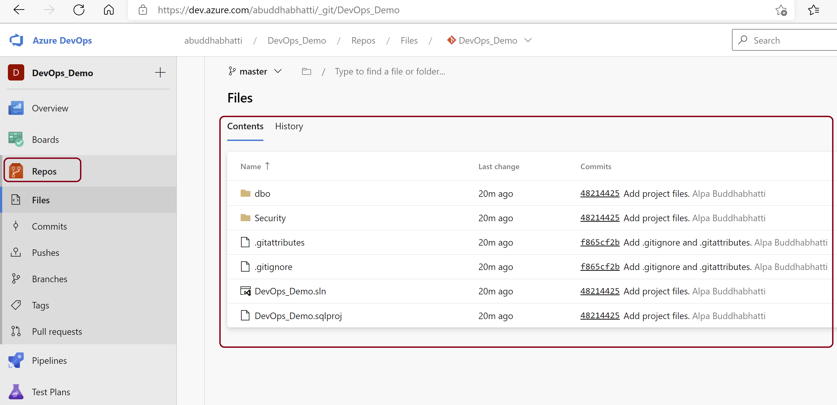
dev.azure.com – Repository

Slide 26
Part 2 – Set up Build Pipeline

Slide 27
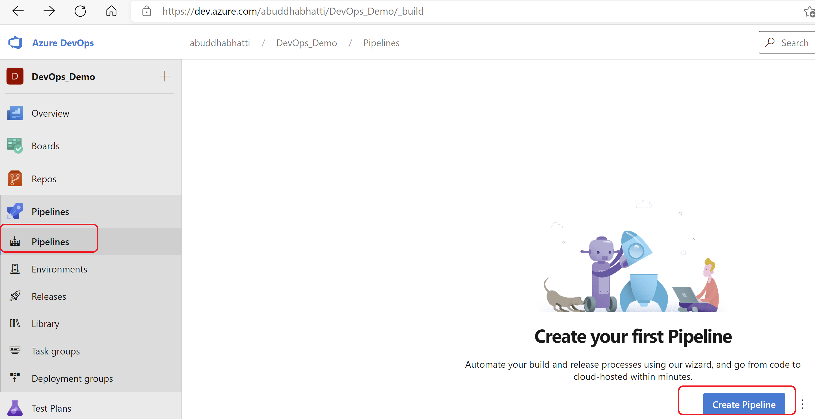
dev.azure.com – Build Pipeline

Slide 28
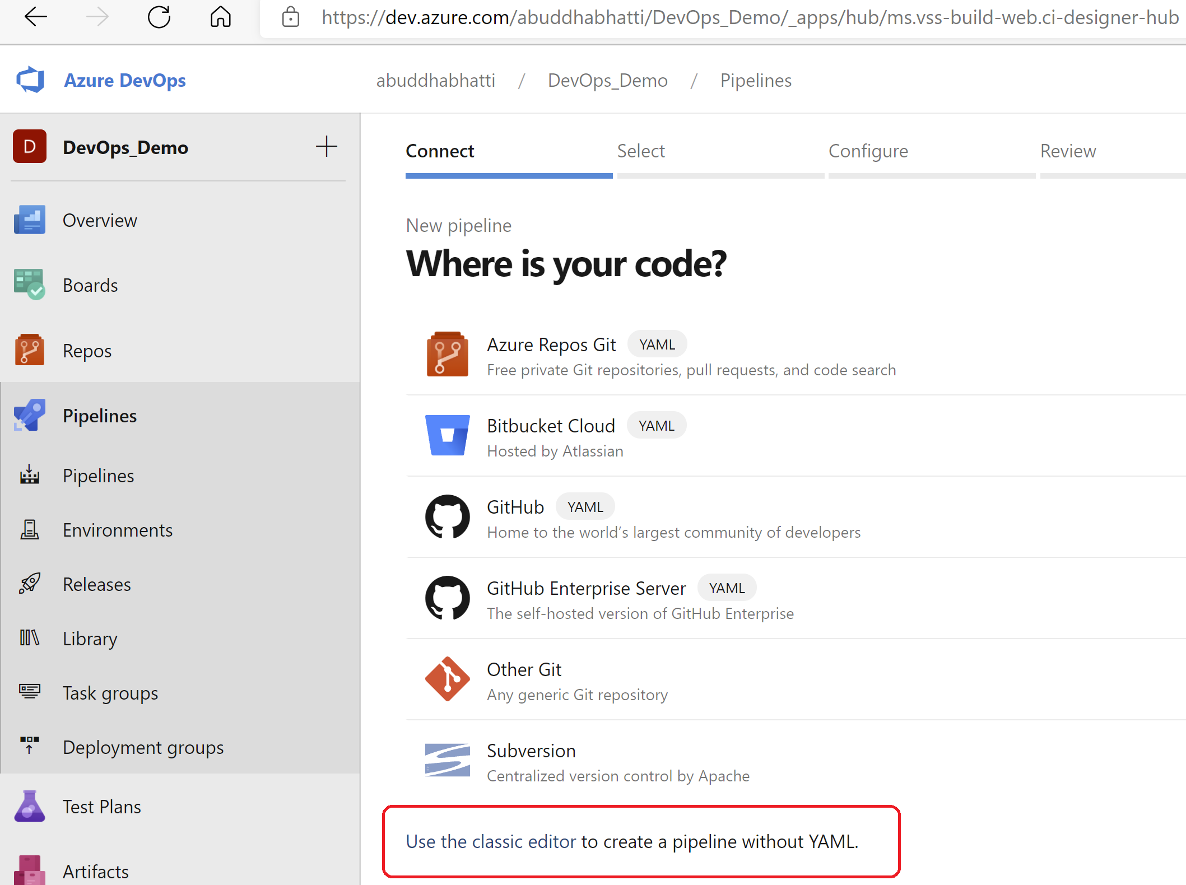
dev.azure.com – Build Pipeline

Slide 29
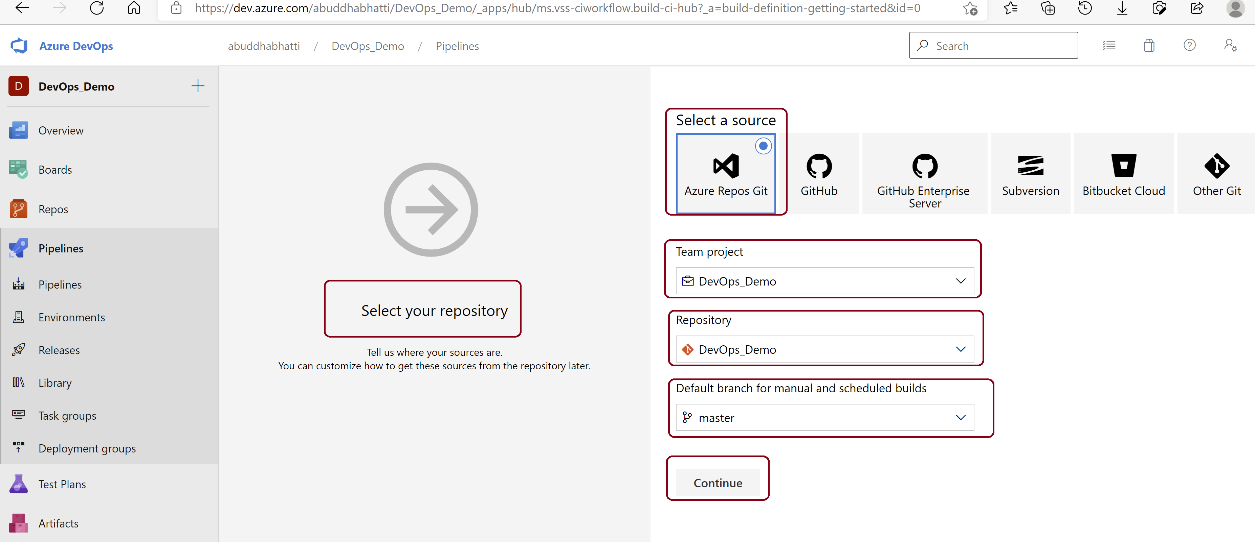
dev.azure.com – Build Pipeline

Slide 30
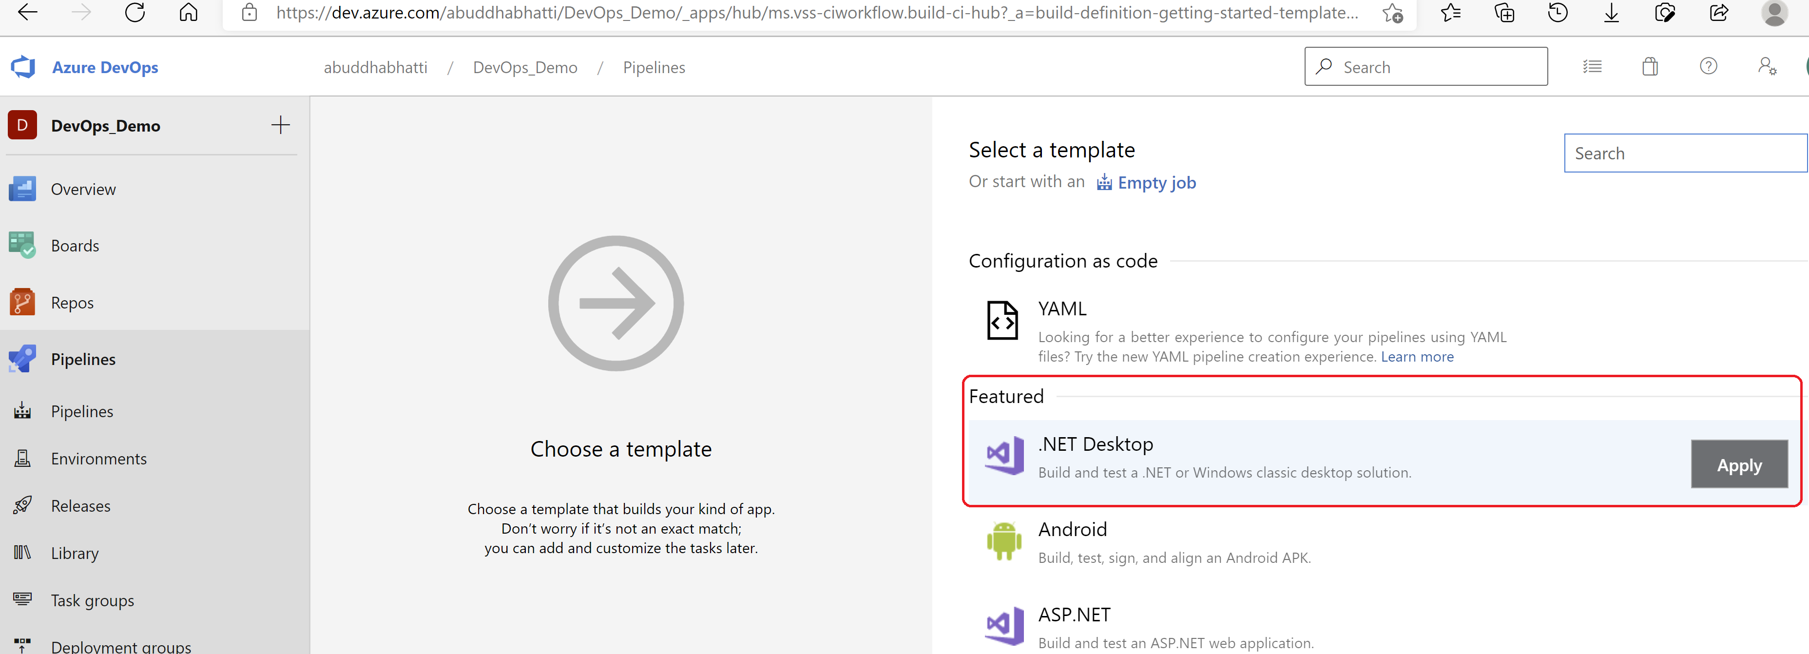
dev.azure.com – Build Pipeline

Slide 31
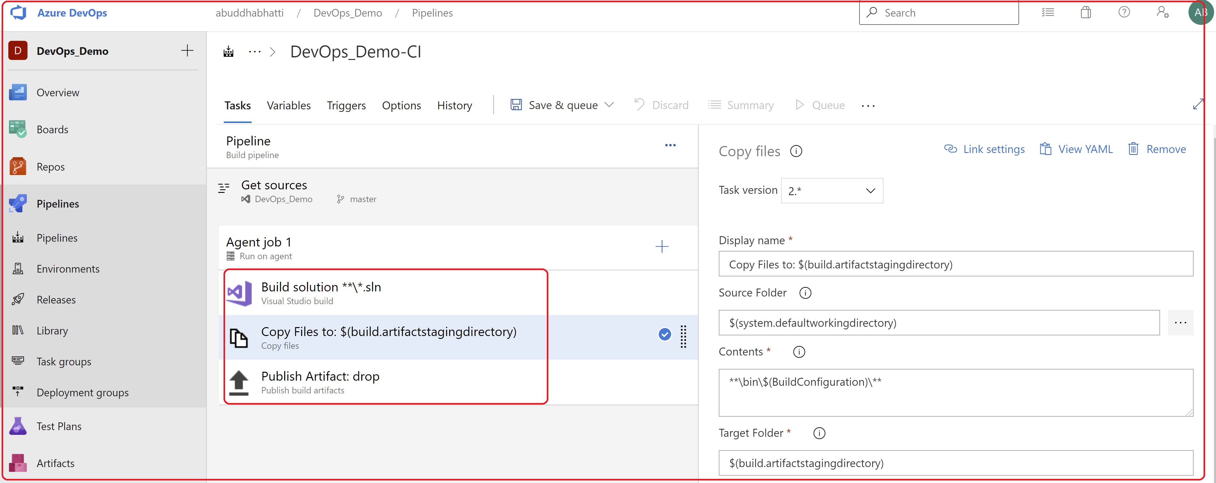
dev.azure.com – Build Pipeline

Slide 32
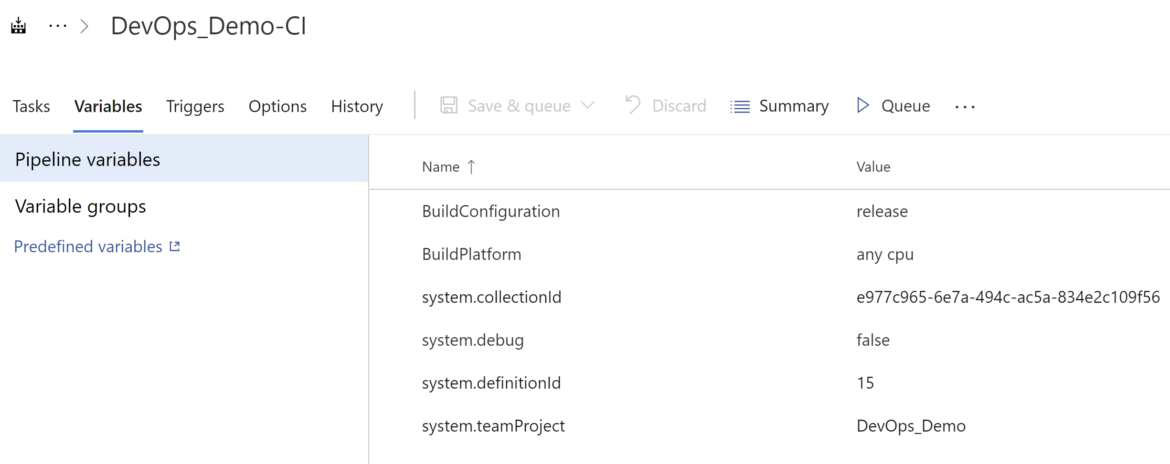
dev.azure.com – Build Pipeline

Slide 33
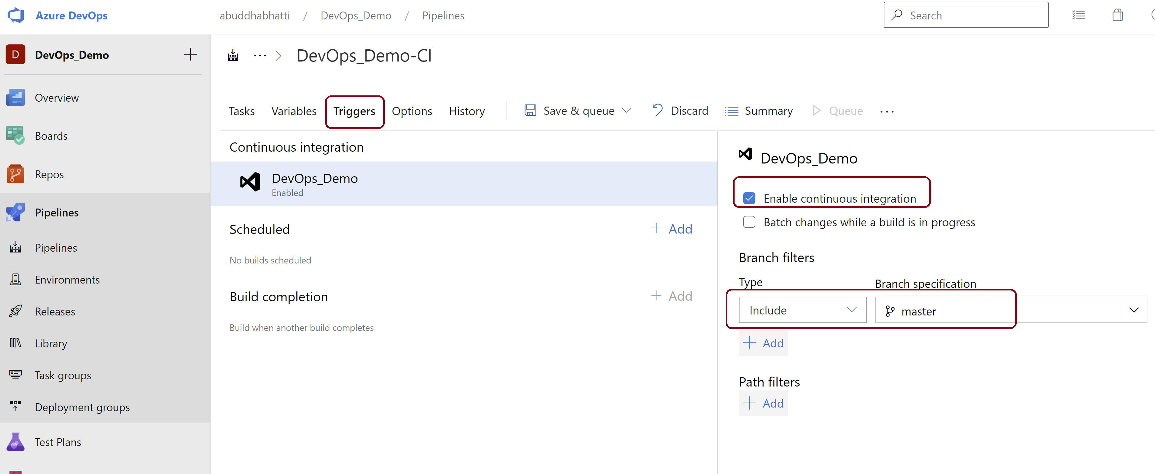
dev.azure.com – Build Pipeline

Slide 34
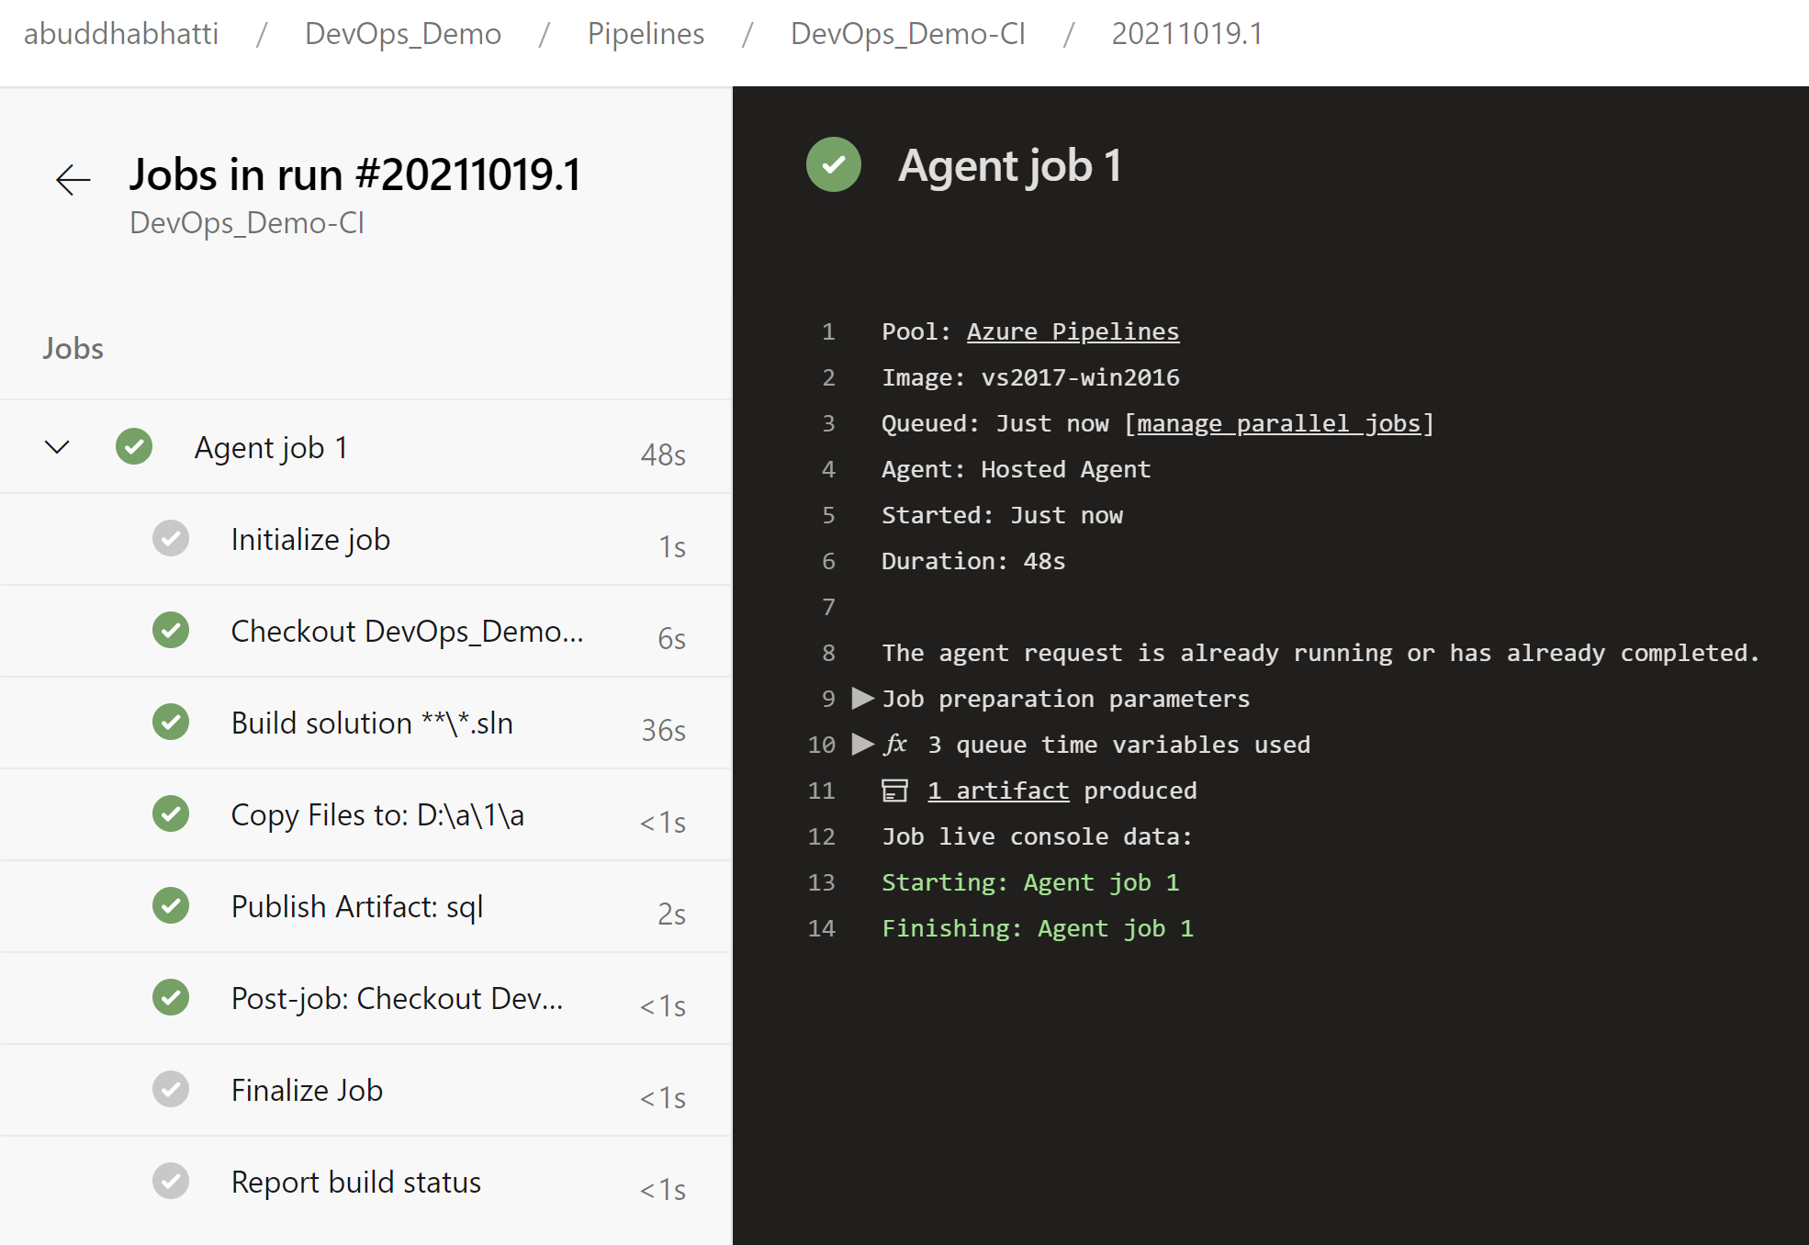
dev.azure.com – Build Pipeline

Slide 35
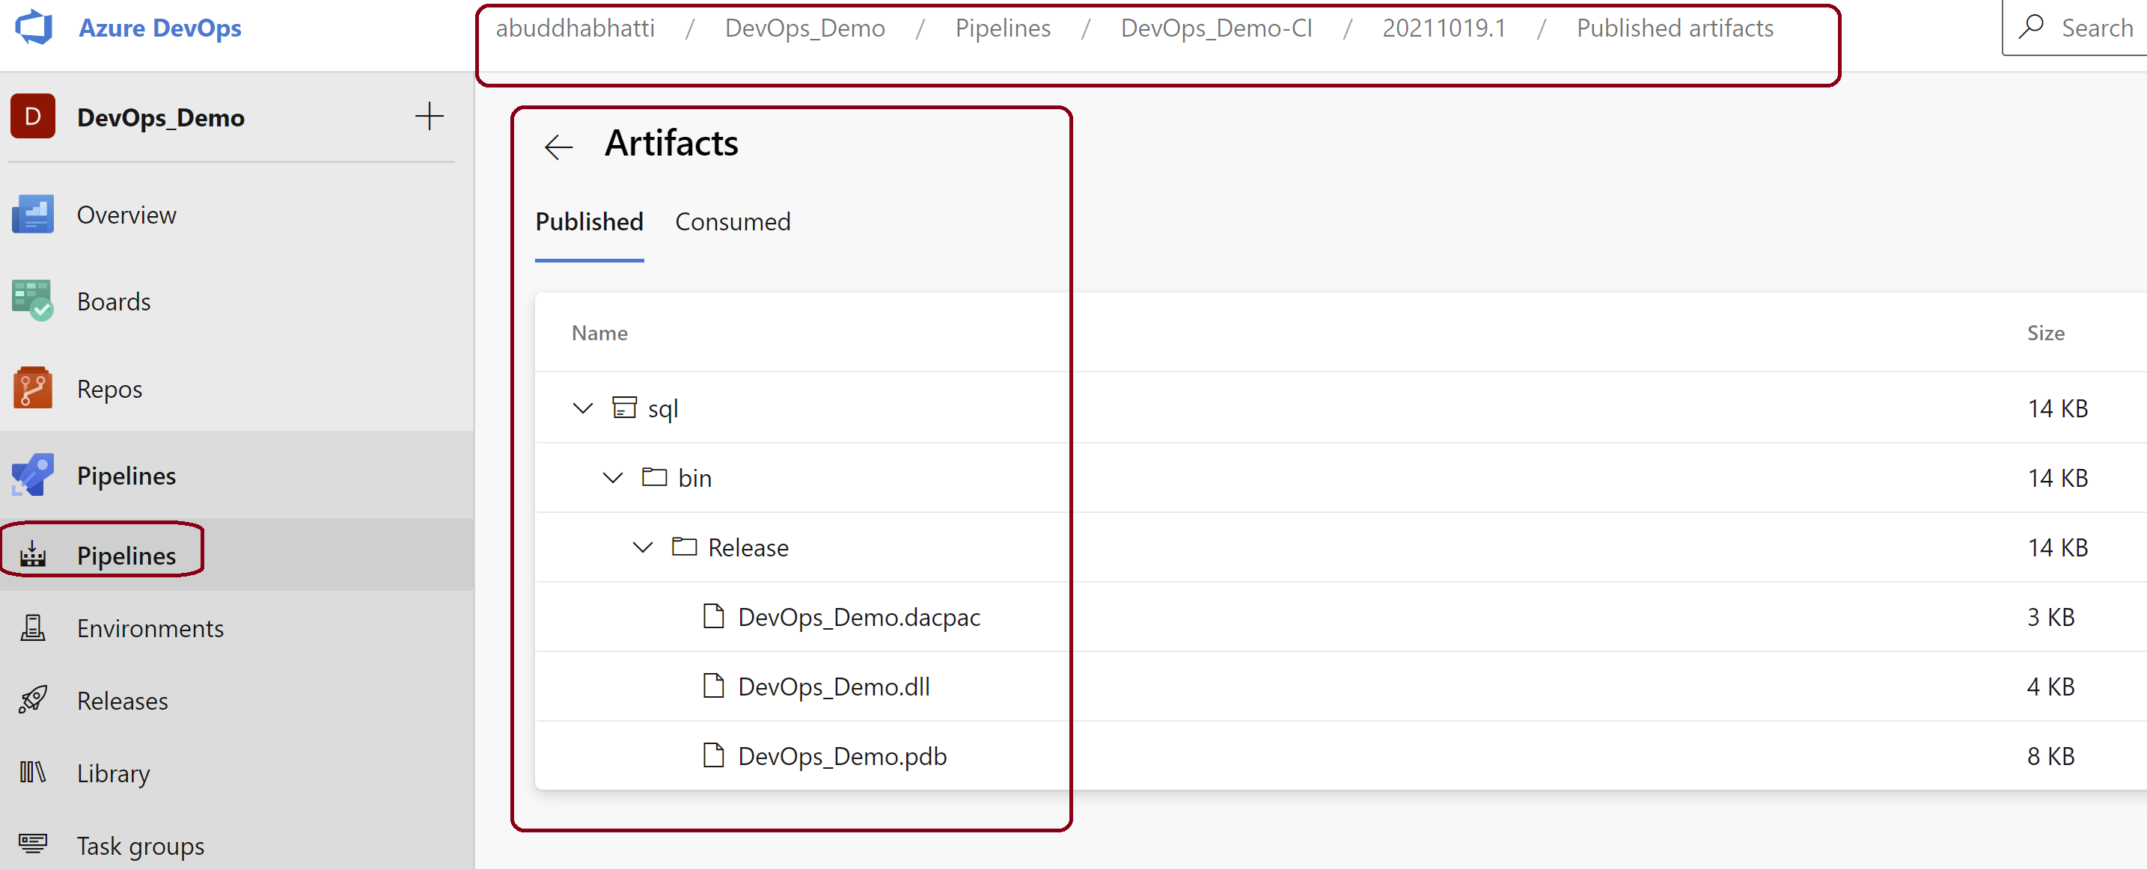
dev.azure.com – Build Pipeline

Slide 36
Part 3 – Set up Release Pipeline

Slide 37
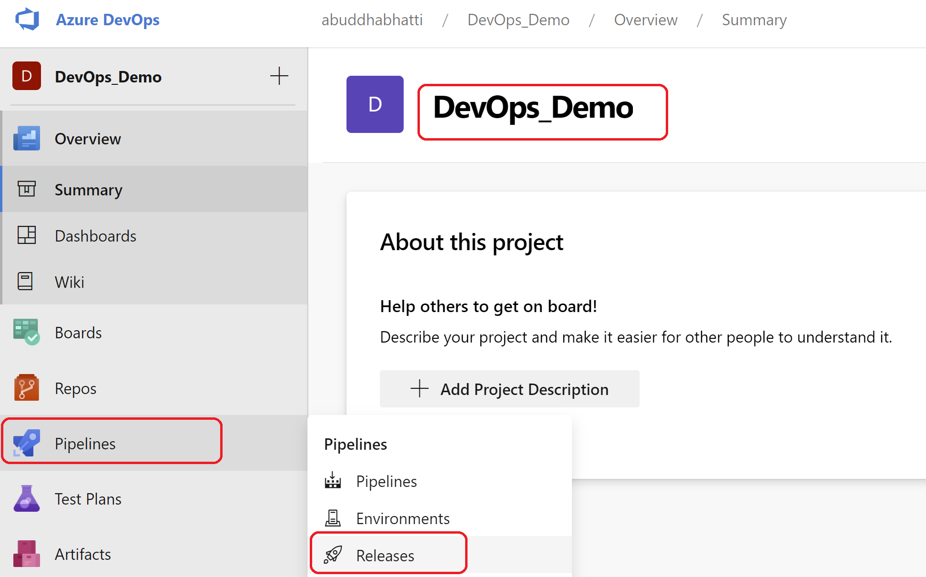
dev.azure.com – Release Pipeline

Slide 38
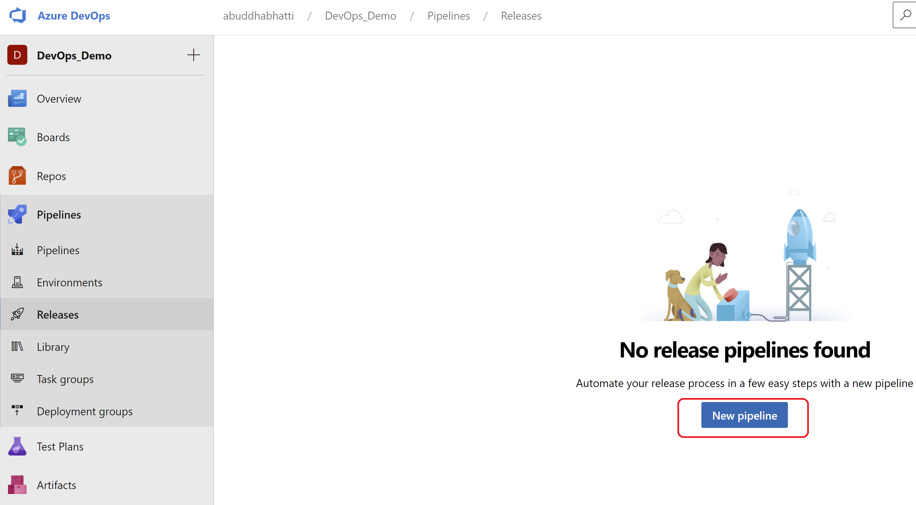
dev.azure.com – Release Pipeline

Slide 39
dev.azure.com – Release

Slide 40
dev.azure.com – Release Pipeline

